Slide 1
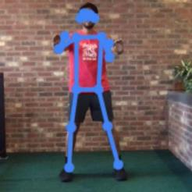
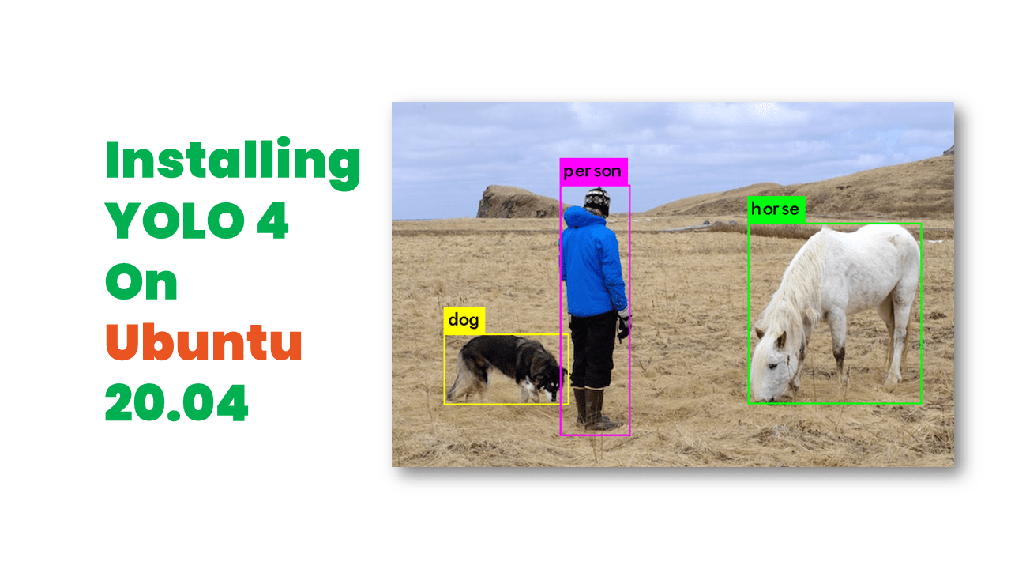
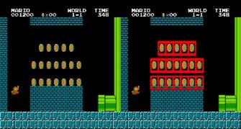

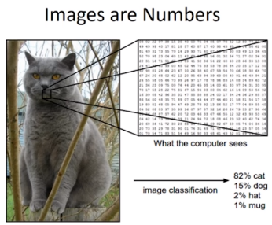
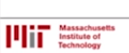
Computer Vision with OpenCV and Python
!svn export https://github.com/opencv/opencv/trunk/samples/data/
Asier Marzo
Examples from:
Alexander Mordvintsev & Abid K. https://opencv-python-tutroals.readthedocs.io/
Adrian Rosebrock https://www.pyimagesearch.com/

Slide 2
Basics:
load and show images
!svn export https://github.com/opencv/opencv/trunk/samples/data/messi5.jpg
Video.

Slide 3
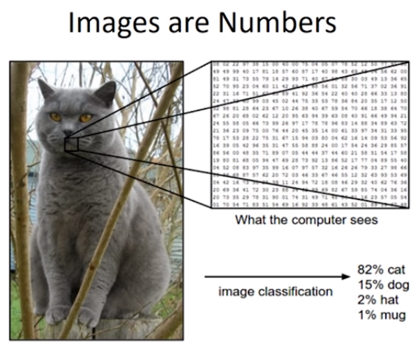
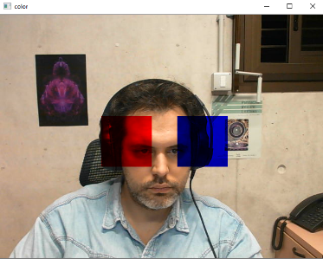
An image is a 2D array of pixels.
Basic pixel Access . Regions of Interest (ROI)
Basic arithmetic

Slide 4
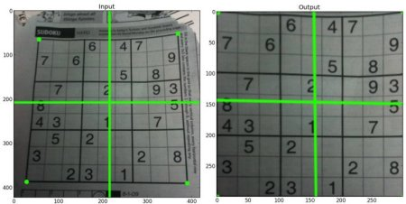
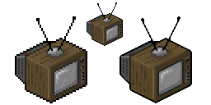
Image Geometric Transformations
Scale and Warp Perspective
For warp they are missing “import matplotlib.pyplot as plt”
Drawing lines, circles, rects, text…
Mouse events
warp
scale
wikipedia

Slide 5
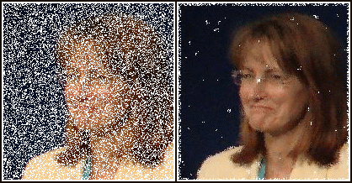
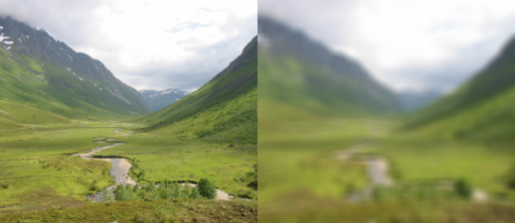
Basic filters
Careful here the code usually has _ instead
Blur and Median.
cv2.blur
!svn export https://github.com/opencv/opencv/trunk/samples/data/opencv-logo.png
Basic GUI Sliders
https://pippin.gimp.org/image-processing/chap_area.html
wikimedia

Slide 6
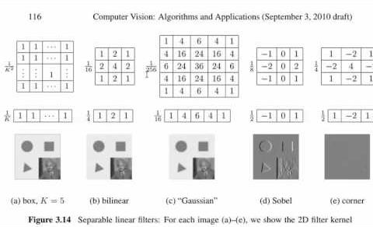
Linear filters

Slide 7
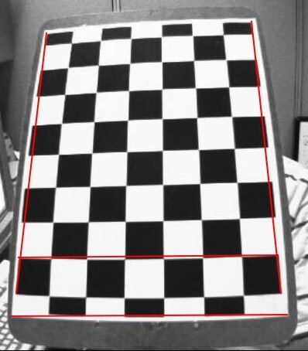
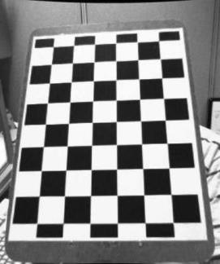
Camera calibration
Use images = glob.glob('./data/*.jpg')
Calibration.
CalibrateCams.py
Pose.

Slide 8
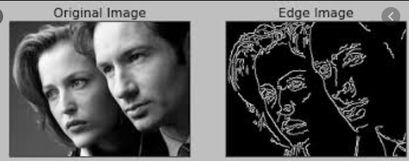
Edge Detection
Sobel.
Canny

Slide 9
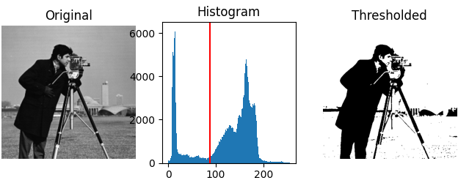
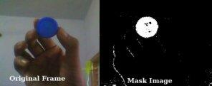
Thresolding
Binary. Adaptative
!svn export https://github.com/opencv/opencv/trunk/samples/data/sudoku.png
Use sudoku.png
Rename xrange to range
By Color range.
Blue pen
scikit-image
opencv-python-tutroals

Slide 10
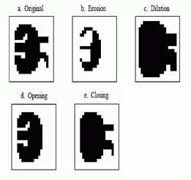


Morphological operators
Erosion, dilatación. Opening, closing.
#defines the kernel
erosion = cv2.erode(img,kernel,iterations = 1)
#when kernel=None a 3x3 square is used, default iters is 1
erosion = cv2.erode(img, None)
opening
closing
Gurpreet Bhatia

Slide 11
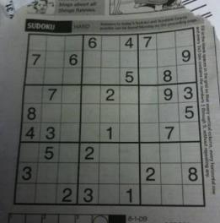
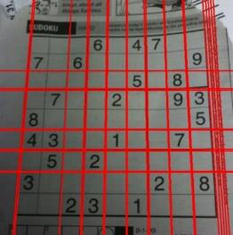

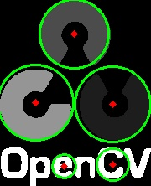
Hough Transform.
Detecting lines
Select the python code
Circles
use opencv-logo.png

Slide 12
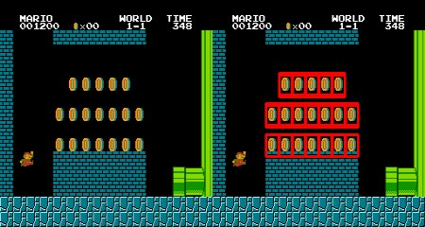
Template Matching
Single Scale
https://github.com/elninojk/OpenCVCoinDetection/blob/master/super_mario.jpeg
https://github.com/elninojk/OpenCVCoinDetection/blob/master/SuperMarioCoin.jpg
Multiscale
More tutorials from OMES

Slide 13
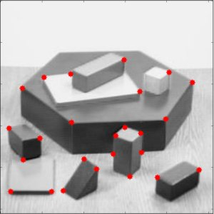
SIFTs and homologies
Shi-Tomasi Corners as interesting points to track.

Slide 14
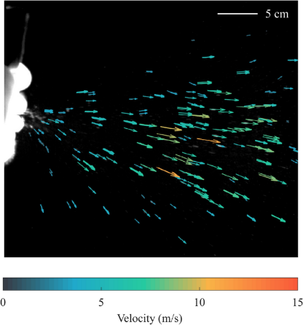
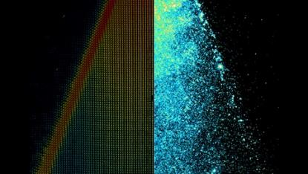
Optical Flow
Lucas-Kanade → Tracking interest points
!svn export https://github.com/makelove/OpenCV-Python-Tutorial/trunk/data/slow.flv
Farneback → Dense flow
!svn export https://github.com/opencv/opencv/trunk/samples/data/vtest.avi
Particle Velocimetry

Slide 15
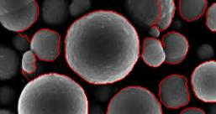
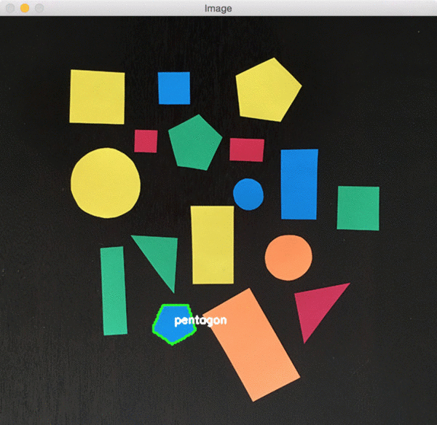
Blobs and Contours
Detecting contours
Use blob “detect_blob.png”
Remove _ from findContours
Features of a contour. 1 2 3
Whiteboard wars.
Handball projection ¦ starter code
https://www.pyimagesearch.com/2016/02/08/opencv-shape-detection/

Slide 16
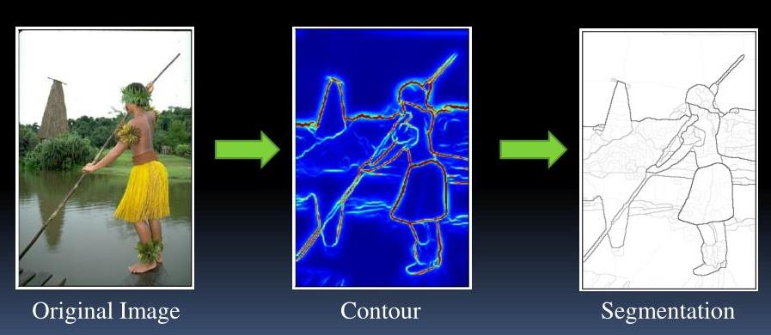
Segmentation
Watershed
Camden Affey

Slide 17
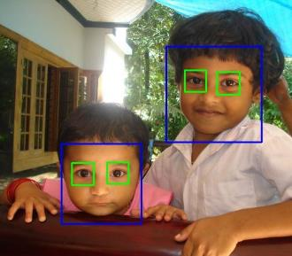
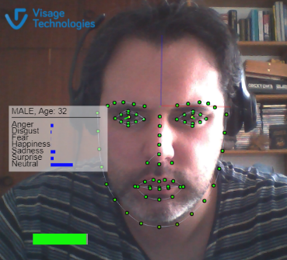
Face tracking
Haar classifiers or this other by Ana Huamán
!svn export https://github.com/opencv/opencv/trunk/data/haarcascades/
haarcascade_frontalface_default.xml and haarcascade_eye.xml
Cool Facial tracker 1
Face search: https://pimeyes.com/en

Slide 18
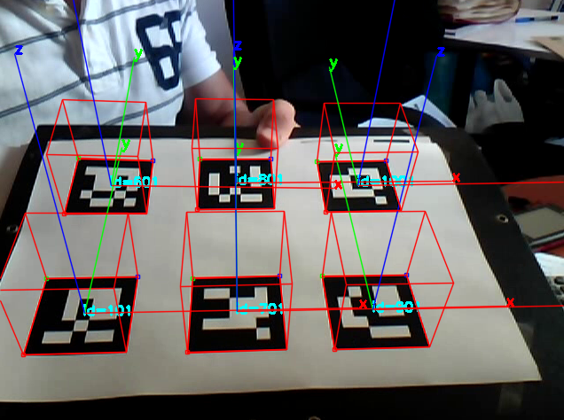
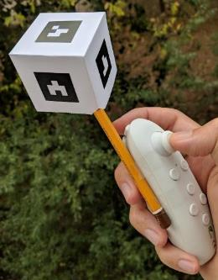
Aruco Markers
Simple Test

Slide 19
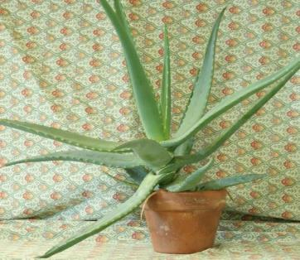
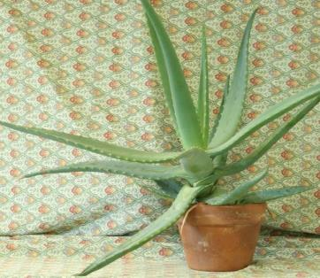
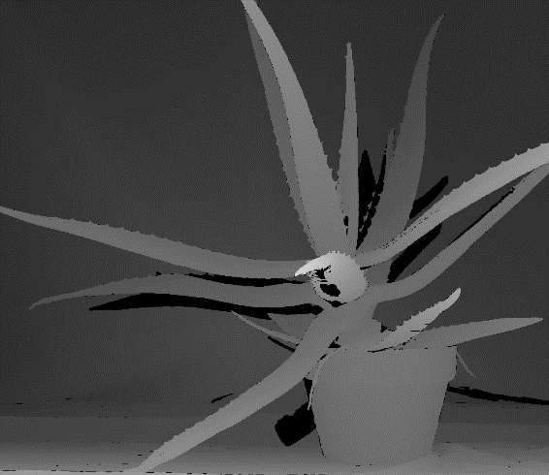
Depth stimation with stereo images (poor’s man Kinect)
Dissimilarity
Use aloeL.jpg aloeR.jpg
left
right
depth

Slide 20
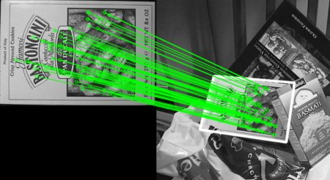
SIFTs and homologies
Shi-Tomasi Corners as interesting points to track.
SIFT and SURF Features
Matching features and getting the homography

Slide 21
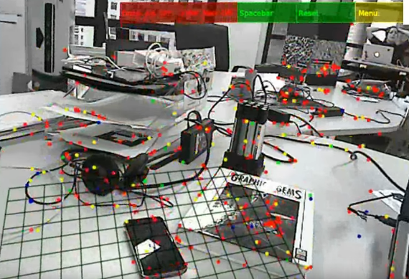
SLAM and PTAM
https://youtu.be/9M1A8Xv2hzQ?t=10

Slide 22
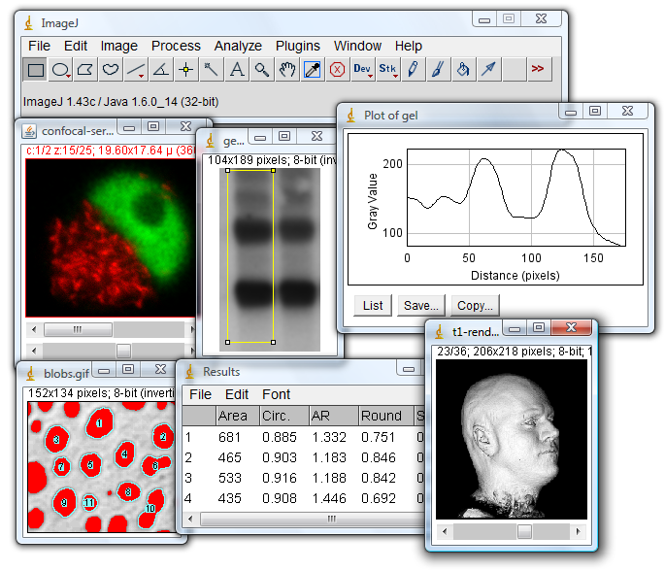
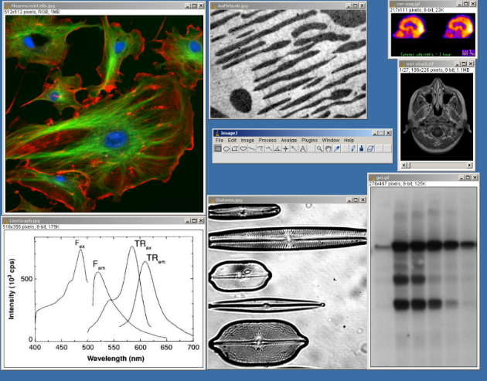
Not all is OpenCV: ImageJ

Slide 23
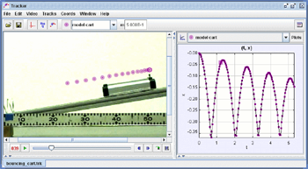
Not all is OpenCV: https://physlets.org/tracker/

Slide 24
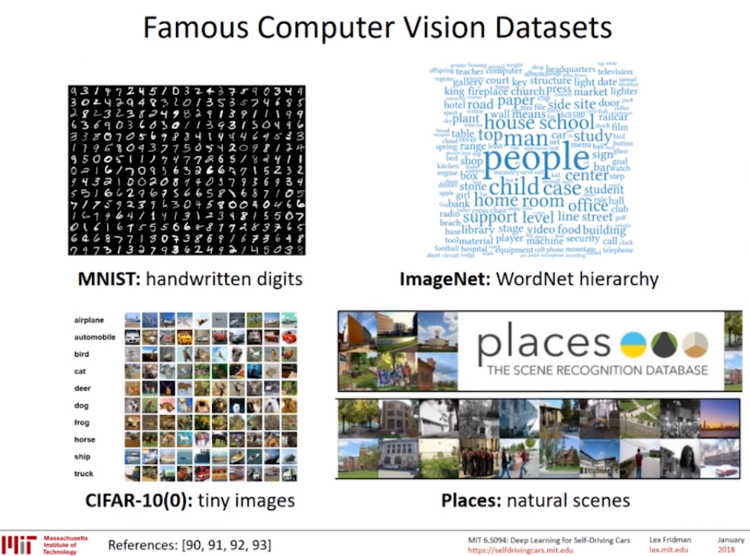
Datasets

Slide 25
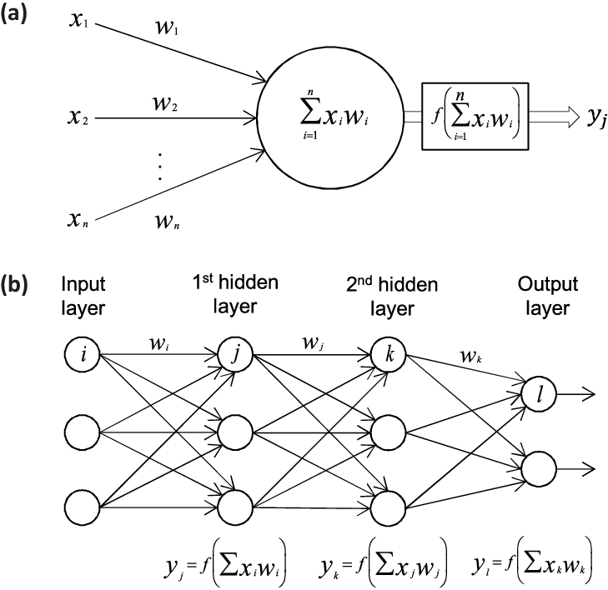
Now we enter Neural Networks territory
Sandra Vieira

Slide 26
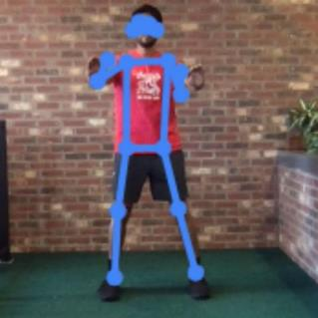
Training a NN to classify images
Teachable Machine
Image Project
Common problems: getting samples with different background, lightning, orientations, scale.

Slide 27
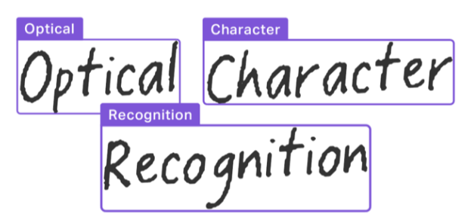
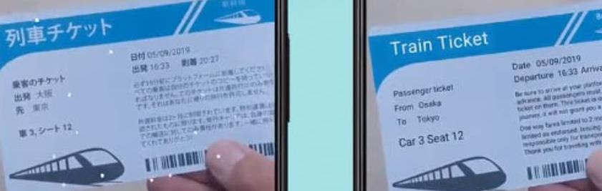
OCR
Google Lens

Slide 28
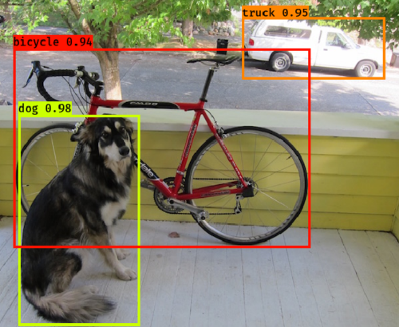
YOLO
Google Collab can cover your needs
Compile and run darknet with YOLO on a virtual machine

Slide 29
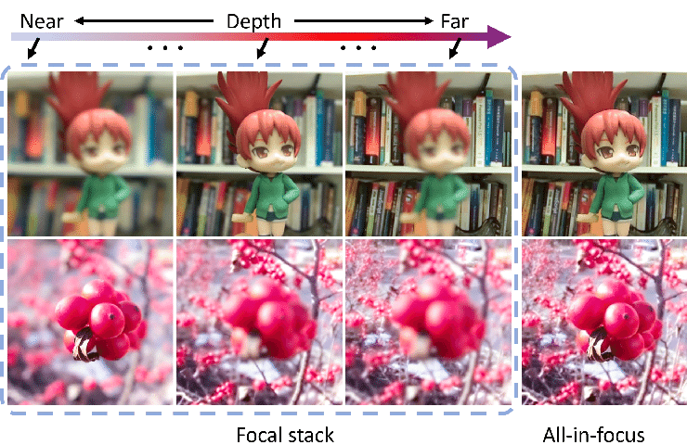
Más técnicas: Focal stack
Tao Zhou

Slide 30
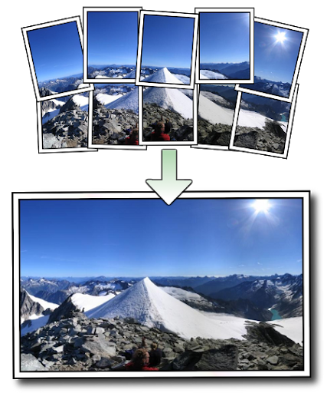
Más técnicas: Panorama stiching
Matthew Brown

Slide 31
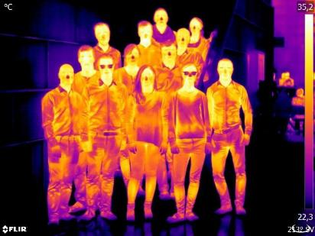
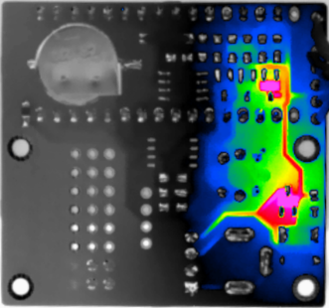

Nuevas cámaras:
FTIR. - calor
Microwave
Teraherz
X-rays, gamma

Slide 32


Nuevas cámaras
Light-field
Femtosecond
Around the corner
Through walls. Through your body.
Ghost Imaging – Quantum – Single-pixel.

Slide 33
Últimos avances
HUMBI Datasets
Robust Change Captioning
Top 10 CV papers 2020

Slide 34
Some common CV devices
Leap Motion. Viewer+Model.
OptiTrack Duo. Cameras+Tracker.
Kinect. Depth, Skeleton.
Occulust Quest: SLAM, Constellation tracking and hand tracking.

